Slide 1
Big Mountain Resort – Revenue Growth Opportunities

Slide 2
Problem identification
Context
Big Mountain Resort - ski resort located in Montana.
It offers spectacular views of Glacier National Park and Flathead National Forest, with access to 105 trails with ability to accommodate skiers and riders of all levels and abilities.
These are serviced by 11 lifts, 2 T-bars, and 1 magic carpet for novice skiers.
The longest run is 3.3 miles in length. The base elevation is 4,464 ft.
The summit is 6,817 ft with a vertical drop of 2,353 ft
The resort recently installed an additional chair lift that has increased the operating cost by about $1.54 M USD.
Current Strategy
To charge a premium on the ticket price above the average prices of resorts in its market segment.
Pain point – current pricing strategy does not provide a good sense of how important some facilities are compared to others.
Expectation
To implement a business strategy that addressed the pain point to influence the ticket prices.

Slide 3
Problem identification
Problem Statement
Identification of opportunities that exists within Big Mountain Resort’s facilities to substantiate increase in the ticket prices in order to increase annual revenue by $1.5 million, to offset the additional operating expense, within the next year.
Scope of Solution – Focus on the following facilities
vertical drop
terrain parks
longest run in the resort
average snowfall
area covered by snow making machines
skiable terrain
night skiing area

Slide 4
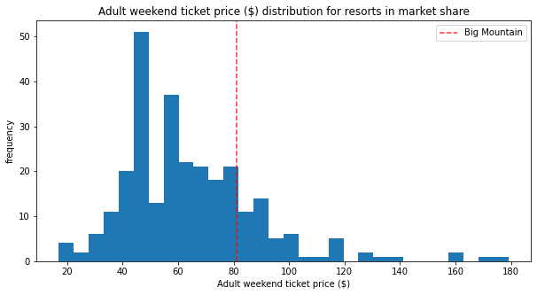
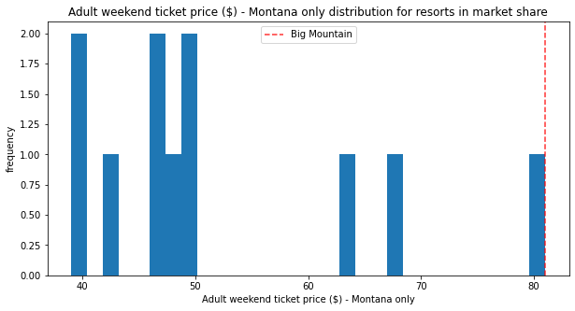
Key Findings
Big Mountain Resort’s actual ticket price – $81.00 USD
Modeled price – $95.87 USD (suggests a strong case for ticket price increase)
Customer footfall 350,000-visitor to the resort, each visitor skis for 5 days
Ticket prices for the resort sits on the higher end compared to prices within Montana.
Inherent assumption – other resorts in the market segment accurately set their prices according to what the market (the ticket-buying public) supports.

Slide 5
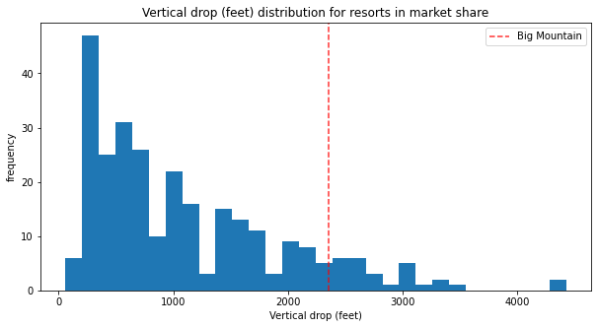
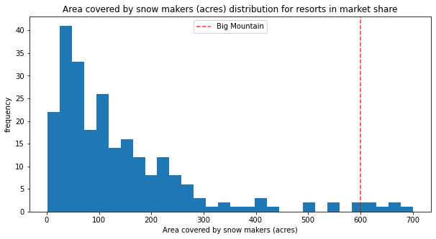
Key Findings
The resort does well for vertical drop, but there are still quite a few resorts with a greater drop.
The resort is very high up the league table of snow making area.

Slide 6
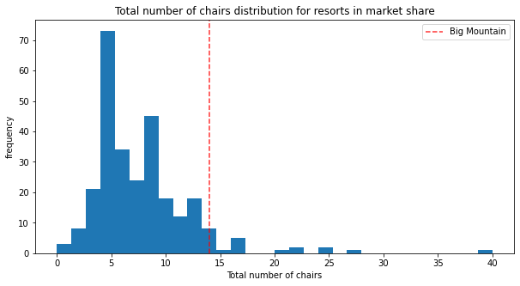
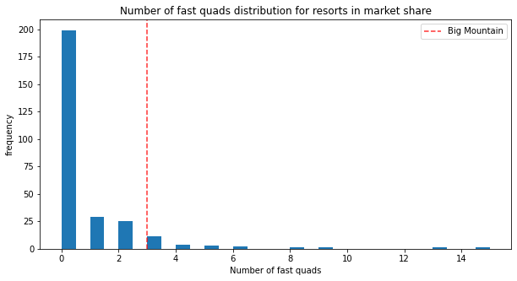
Key Findings
It has amongst the highest number of total chairs, resorts with more appear to be outliers.
Most resorts have no fast quads. Big Mountain Resort has 3, which puts it high up that league table. There are some values much higher, but they are rare.

Slide 7
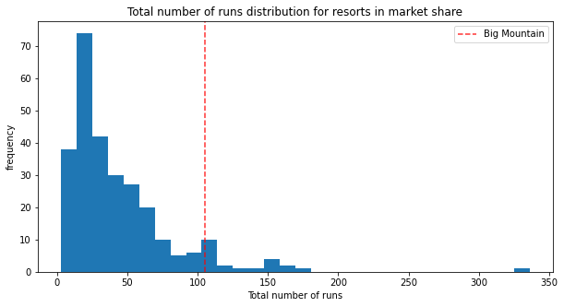
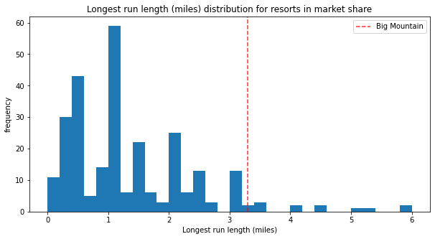
Key Findings
Big Mountain Resort compares well for the number of runs. There are some resorts with more, but not many.
The resort has one of the longest runs. Although it is just over half the length of the longest, the longer ones are rare.

Slide 8
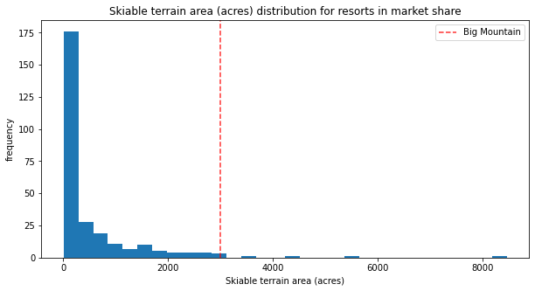
Key Findings
Big Mountain is amongst the resorts with the largest amount of skiable terrain.

Slide 9
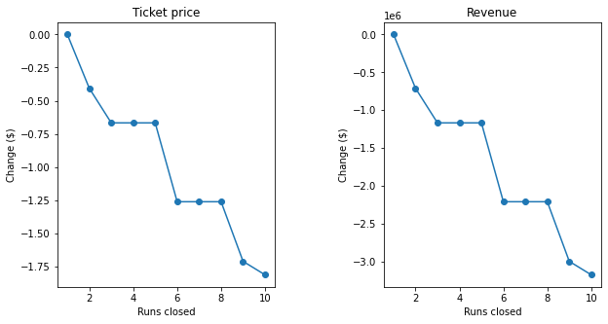
Modeling results
Model scenario 1: Permanently shutting down up to 10 of the least used runs.
Different scenarios were analyzed from closing 1 to maximum 10 runs.
The model showed that closing one run makes no difference.
Closing 2 and 3 successively reduces support for ticket price and so revenue down by $1.2M.
If Big Mountain closes 3 runs, it seems they may as well close 4 or 5 as there's no further loss in ticket price or revenue.
Increasing the closures down to 6 or more leads to a large drop in ticket price and revenue with as much as $3M by closing 10 runs.

Slide 10
Modeling results
Model scenario II: Increase the vertical drop by adding a run to a point 150 feet lower down but requiring the installation of an additional chair lift to bring skiers back up, without additional snow making coverage.
This scenario increases support for ticket price by $1.99. Over the season, this could be expected to amount to $3,474,638 in revenue.
Model scenario III: Same as scenario II but adding 2 acres of snow making cover.
This scenario increases support for ticket price by $1.99. Over the season, this could be expected to amount to $3,474,638 in revenue. Increase in snow making area by 2 acres made no difference.
Model scenario IV: Increase the longest run by 0.2 mile to boast 3.5 miles length, requiring an additional snow making coverage of 4 acres.
It did not have any difference in the ticket prices or revenue.

Slide 11
Recommendation
Based on the modeling results, the objective of pricing the ticket based on the other facilities the resort has to offer will be best served by model scenario II.
Model scenario II: Proposed Actions
Increase the vertical drop by adding a run to a point 150 feet lower down
Install an additional chair lift to bring skiers back up the slope
Proposed Results
This scenario increases support for ticket price by $1.99. From $81.00 USD to $82.99 USD
Over the season revenue generation - $3,474,638 USD.
This supplants the $1.5M USD cost of the new chair lift bringing its simple payback on investment to less than 1 year.

